Slide 1
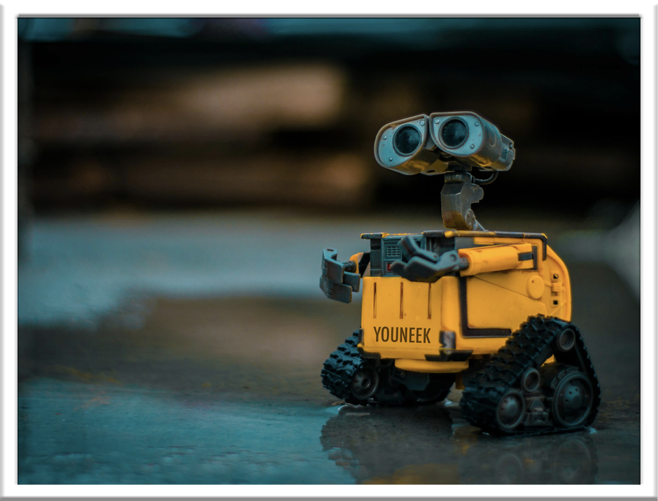
YOUNEEK MIND
Terminal application by Stephanie Duffieux

Slide 2
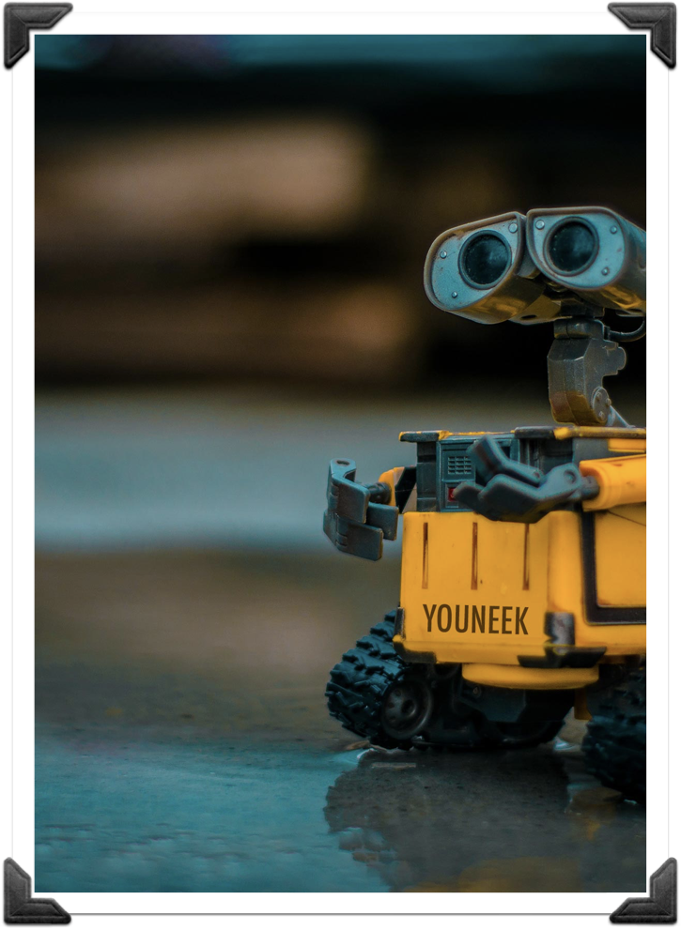

OVERVIEW OF THE APPLICATION
Youneek Mind is designed to teach children with autism spectrum disorders the meaning of empathy, how it affects our interactions with others and how it helps us to adjust to social situations.
Original Photo by Lenin Estrada on Unsplash (edit S.Duffieux)

Slide 3
OVERVIEW OF THE APPLICATION
According to Professor Lenroot, from Neuroscience Research Australia, experiencing empathy is one of the biggest challenges for children with autism spectrum disorders.
Link to Professor Lenroot’s research:
https://www.neura.edu.au/develop-empathy-study-autism-spectrum-disorders/
Original Photo by Lenin Estrada on Unsplash (edit S.Duffieux)

Slide 4
FEATURES AND OVERALL STRUCTURE
Youneek Mind is the story of a little Robot who takes the user on an adventure to Kind Land.
Youneek presents the user with case scenarios that will help him obtain life bars.
If the user answers correctly (by showing empathy) Youneek is able to move to the next stop until he reaches his final destination.
Original Photo by Lenin Estrada on Unsplash (edit S.Duffieux)

Slide 5
FEATURES AND OVERALL STRUCTURE
Youneek Mind is the story of a little Robot who takes the user on an adventure to Kind Land.
Youneek presents the user with case scenarios that will help him obtain life bars. If the user answers correctly (by showing empathy) Youneek is able to move to the next stop until he reaches his final destination.
Original Photo by Lenin Estrada on Unsplash (edit S.Duffieux)

Slide 6
IMPORTANT PARTS OF THE CODE
Game produces printed output using Classes & Methods for the main parts of the game:
Youneek life bars.
Case scenarios (kept short to suit target audience).
User input (selecting answers, continue game, etc.).
Original Photo by Lenin Estrada on Unsplash (edit S.Duffieux)

Slide 7
IMPORTANT PARTS OF THE CODE
Invalid inputs are handled with a friendly error message prompting the user to enter the correct value
Game produces text in various colours using the Colorize gem.
Artii Gem is use to empathise the name of the game and each stop.
Original Photo by Lenin Estrada on Unsplash (edit S.Duffieux)

Slide 8
YOUNEEK MIND
With repetition of use, Youneek Mind could help the user to remember each case scenario and how they were able to show empathy and therefore apply this to their everyday life.
Original Photo by Lenin Estrada on Unsplash (edit S.Duffieux)

Slide 9
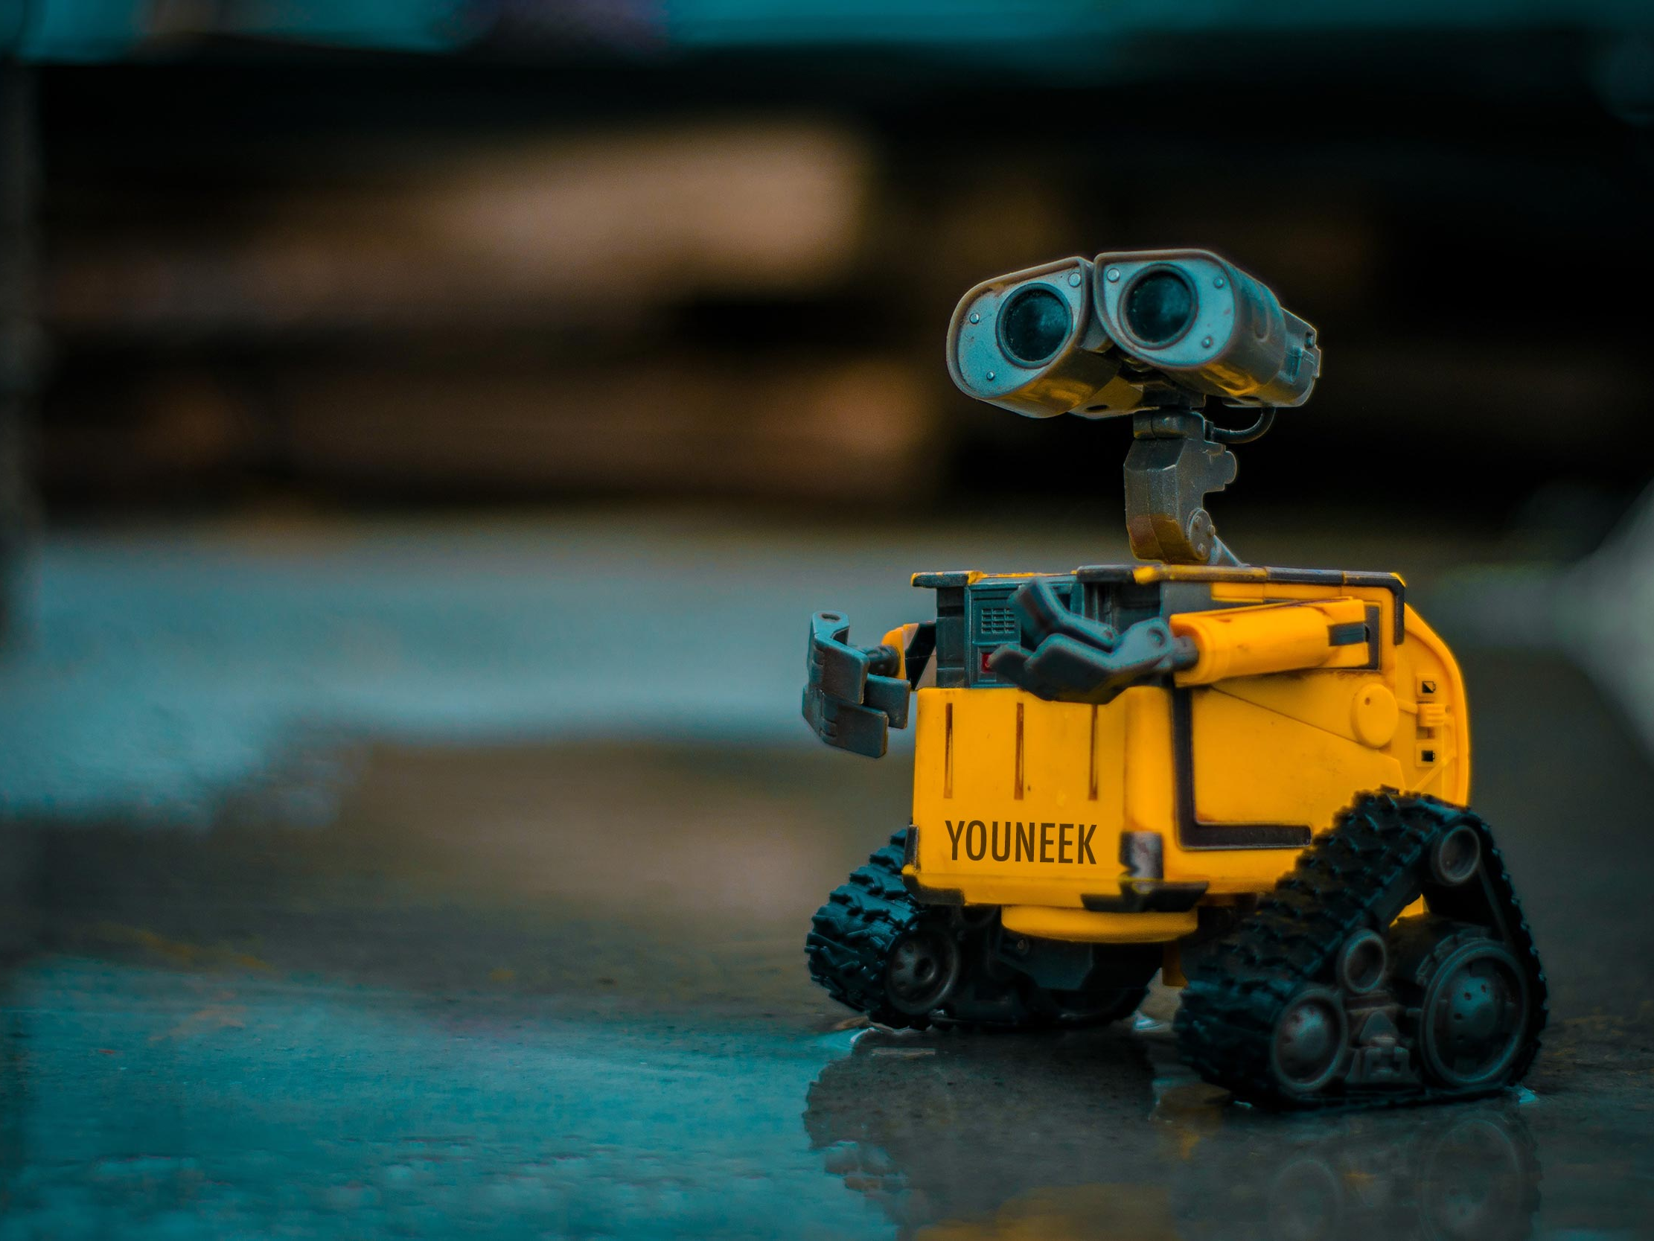
“Empathy is seeing with the eyes of another, listening with the ears of another and feeling with the heart of another.” – Alfred Adler.

